Slide 1
INVESTMENT CASE STUDY SUBMISSION
Group Name:
Abhijith NV
Srividya Ravichandran
Nanditha GN
Krishnan Raghupathi

Slide 2
Key Objectives
Identify the best sectors, countries and suitable investment type for making investments
Provide recommendations to the CEO of Spark Funds on the best sectors, countries and companies that Spark Funds should invest in
Ensure that the recommendations are aligned with the following constraints
Investment round should be in the range of $5 to $15 million
Companies should be in English-speaking countries
Investments should be in where others are also investing

Slide 3
Process Workflow
Business Understanding
Data Understanding
Data Preparation
Recommendations
Conclusions
Data Analysis

Slide 4
Business Understanding
Business Objective
Provide insights to the CEO of Spark Funds on the current global trends in investments across sectors
Provide recommendations to the CEO on the sectors, countries and companies that are best suited for making investments
Recommendations should be aligned with the following constraints
Investments should be in the range of $5 to $15 million per round
Investments should be only in English-speaking countries
Recommendations should be aligned with Spark Funds strategy of investing where others are also investing

Slide 5
Data Understanding
Data Sources
companies –Contains details of the companies for which investments are made
rounds2 - Details of investment funding rounds for companies by the investors
mapping - Sector classification that maps the various investment categories into 8 broad sectors
High level view of data
No. of unique companies in rounds2: 66368
No. of unique companies in companies: 66368
Unique key for each company in companies data : permalink
rounds2 and companies do not contain any unmatched companies
Merged data (round2 + companies) contains 114949 observations
Data Quality
Encoding issues exist in permalink & names column of companies data source and company_permalink column of rounds2 data source
Few categories in mapping data source had 0 instead of the string ‘na’
Some categories in the companies data source were not there in the mapping data source

Slide 6
Data Preparation
Missing value treatment
raised_amount_usd column in the rounds2 data, which is required in the analysis, had a lot of null values
Following two approaches were analysed
Dropping rows with null values
Imputing the null values with the 75% percentile value
Decided to go with the option of dropping rows with null values for following reasons
Percentage of null values (17.39%) is not very significant
> 80% of rows will be available even after dropping rows with null values
Outcome of 2nd approach shows “Undisclosed” as one of the preferred investment types which not make business sense practically speaking
Mapping of unmatched sectors in mappings
All unmatched primary sectors are mapped to Others main sector

Slide 7
Data Analysis - Outcome
Status of companies
Closed status of companies are not excluded from the analysis as goal is to understand the overall investment pattern by sectors and countries and not by individual companies
Average funding amount for 4 funding types:
Venture Funding – $11.75 million ← Falls in $5 - $15 million range
Angel Funding – $0.96 million
Seed Funding - $0.72 million
Private Equity - $73.31 million
Funding type most suitable for investment by Sparks Fund – Venture Funding
Top 3 English speaking countries suitable for investment
United States (USA)
United Kingdom (GBR)
India (IND)

Slide 8
Data Analysis - Outcome
 | USA | GBR | IND
# of Investments | 12150 | 628 | 330
Total investments (USD millions) | $108,531.35 | $5,436.84 | $2,976.54
Top sector (By # of investments) | Others (2951) | Others (147) | Others (110)
Second sector (By # of investments) | Social, Finance, Analytics, Advertising (2714) | Social, Finance, Analytics, Advertising (133) | Social, Finance, Analytics, Advertising (60)
Third sector (By # of investments) | Cleantech / Semiconductors (2350) | Cleantech / Semiconductors (130) | News, Search and Messaging (52)
Company receiving highest investment (Top Sector) | Kasenna Sector: Others | Tribold Sector: Others | LimeRoad Sector: Others
Company receiving highest investment (2nd best Sector) | DataTorrent Sector: Social, Finance, Analytics, Advertising | SimilarWeb Sector: Social, Finance, Analytics, Advertising | Financial Information Network & Operations Pvt Sector: Social, Finance, Analytics, Advertising

Slide 9
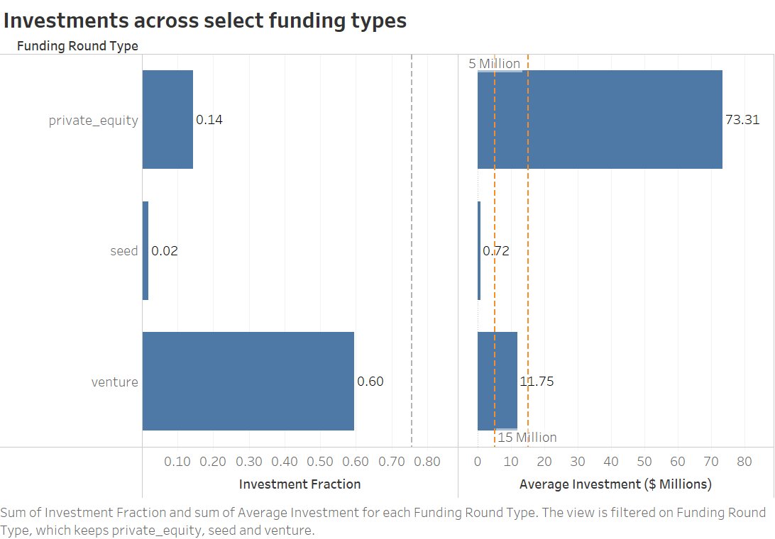

Slide 10
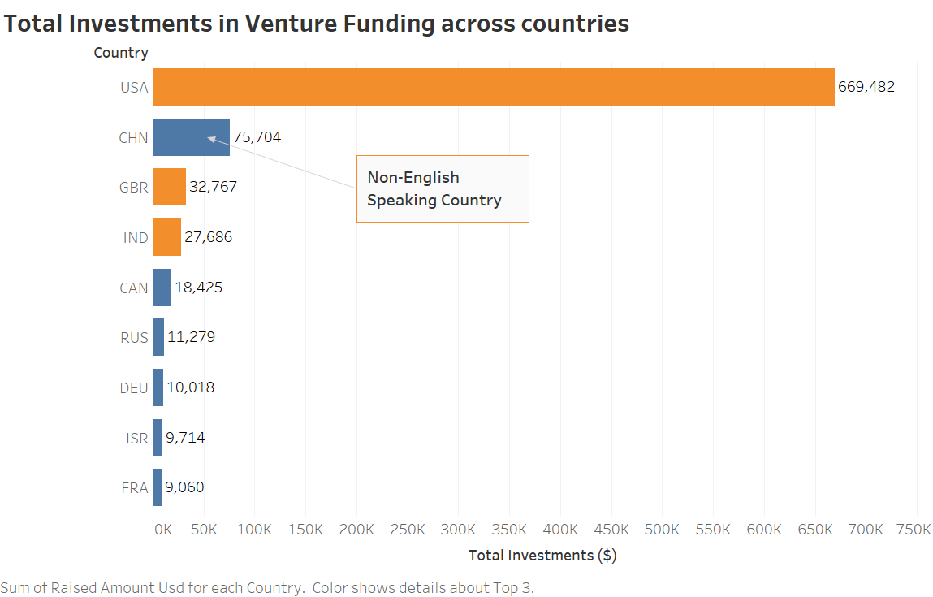

Slide 11
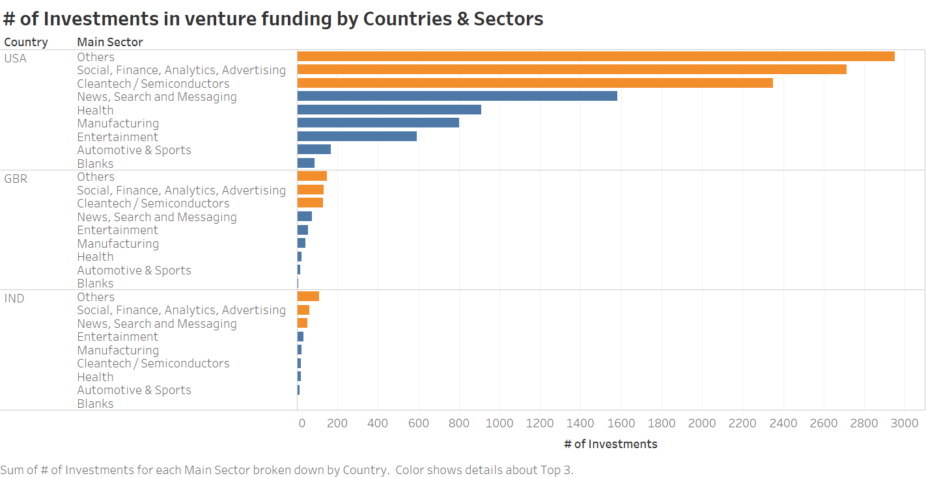

Slide 12
Conclusions
Key Observations
Venture funding is most suitable funding type for Spark Funds
USA, UK & India are the top 3 English-speaking countries where most others are investing
Others sector attracts the maximum no. of investments in all the 3 countries (USA, UK, India)
Social, Finance, Analytics, Advertising sector attracts the second most no. of investments in all the 3 countries (USA, UK, India)

Slide 13
Recommendations
Although Others sector attracts the maximum # of investments across all the 3 countries it does not make business sense to invest in Others sector due to lack of domain focus. Hence our recommendation is that Sparks Funds should invest in Social, Finance, Analytics , Advertising sector, which is a close 2nd to Others sector in terms of # of investments, in all the 3 English speaking countries (USA, UK, India)
Top 5 recommended active Companies to invest in Social, Finance, Analytics , Advertising sector
USA | GBR | IND
DataTorrent | SimilarWeb | TravelGuru*
Tongal | Zopa | ShopClues.com
Origami Logic | myThings | Shiram Credit
MediaVast | OpenGamma | ApnaPaisa
Damballa | SportPursuit | Manthan Systems
* Even though Financial Information Network & Operations Pvt is the top invested Indian company it is no longer operational. TravelGuru is the second best company.

